Slide 1
Federation and The Australian Constitution
Learning intentions:
Understand what why and how Australia federated and what the constitution is.
Success criteria:
Complete a set of questions relating to Federation and the Constitution.

Slide 2
Recall
What date did Australia federate?
What is federation?
What is the constitution and why was it needed for federation?

Slide 3
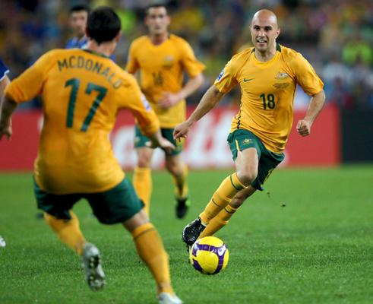

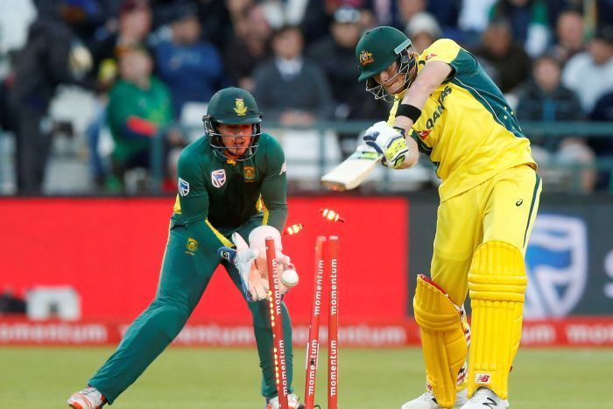



List at least 3 of the rules of your favourite sports team

Slide 4
The Australian Constitution http://www.abc.net.au/btn/story/s3939299.htm
Write these questions in your notes. Don’t forget to leave space to answer them!
True or false? The Constitution is the most important document in the whole country?
When was it mostly written?

Slide 5

Australian Constitution
The written document containing the principles and laws that describe the powers and duties of the Australian Government.

Slide 6

Student activity
Constitution worksheet
Complete the worksheet or it is homework!

Slide 7
In-Class Activity
You are to create your own constitution for the school. This should include the rules you think are important at NSHS.

